Slide 1

Senior Project 1
Group presentation
February 4th, 2022
Professor Yu
"Everything Covid: One Stop Shop"
Group Members
Demario Asquitt
Steffi Graham
Jermel Watson
Allan Muir

Slide 2

Tasks assignments
Homework #1
Read the rhetoric situation and extended definition reading materials on the course content page at the course Blackboard site. Then write an audience analysis of your candidate capstone project idea to clarify the following points:
Define the following audiences of your project:
Jermel- Primary Audience: those people (adoption decision maker) who will adopt the result of your project.
Allan/Jermel-Secondary Audience: those people your primary audience needs in the actual adoption process.
Allan/Demario Gatekeepers: individuals who can prevent your project from reaching your primary audience.
Allan/Demario/Jermel/ Steffi -Watchdogs: those who can rebroadcast your project to others with their own thought/interpretation.
Steffi Write a single-paragraph rhetoric to support your initial project idea.

Slide 3
Project Definition
We are creating an online platform with a back-end database (Everything Covid- one stop shop) that provides goods services to protect individuals from spreading the covid-19 virus as best as possible.

Slide 4
Primary Audience
The primary audience or target audience that we are aiming to reach are all those who are at risk of being subtlety or majorly affected by the Covid-19 virus. This includes:
Men and Women between the ages of 21 through 85. This is because the effects of the Covid-19 virus is prominent in this age range. It is seen where older adults are more likely to get severely ill from COVID-19. More than 81% of COVID-19 deaths occur in people over age 65.
The number of deaths among people over age 65 is approximately 80 times higher than the number of deaths among people aged 18-29.
Our primary audience also involves:
those who are experiencing symptoms of the virus,
those who are currently afflicted with the Covid-19 virus,
and those currently in quarantine.
We also serve those who are looking for vaccination sites, those who need to take the vaccine and those who want to learn more about the vaccine and other materials.
Our primary audience extends to the lower, middle and upper class.

Slide 5

Secondary Audience
The secondary audience that we are aiming to reach are people who are not directly affected by the Covid-19 virus but those who make Covid related materials such as doctor and scientist who makes the vaccines such as Pfizer, Moderna and Johnson & Johnson, mask manufacturers, Covid vaccine test kits creators and those who have a lot of knowledge or experience to share. Our secondary audience includes anti mask enforcers such as Caleb Wallace, a leader in the anti-mask movement in central Texas, who became infected with the coronavirus and has been in an intensive care unit

Slide 6
Gate Keepers
The gatekeepers would primarily be entities in the advertising field such as Facebook, Google, radio and cable television. They are the ones who depending on their approval can let the broader population be aware of the service that we have to offer.

Slide 7
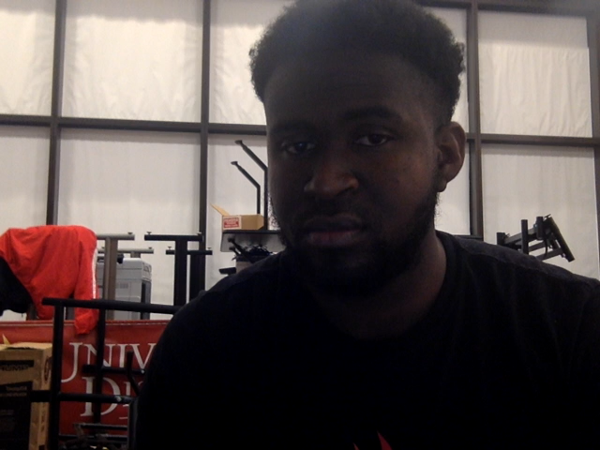
Watchdogs
Medical professionals such as the CDC and scientist who knows how important it is to protect and prevent the spread of the Covid-19 pandemic

Slide 8
I know for many of us, just hearing the words covid-19, pandemic, lockdown truly makes us shiver and may even surface atrocious experiences even to this day. Dating back to January 20th, 2020, which was the day the United States confirmed their first COVID-19 case by the CDC; things took an unfavorable turn. Here we are 5.7 million deaths worldwide and 893 thousand deaths in the US later: including family and friends of many of us. With over four different variants here in the US and we seem to still be counting, we believe as a group that more serious preventative measures are needed as it is almost safe to say that this covid-19 virus is here to stay and maybe even safer for us to embrace our new lives going forward with this virus as a part of it. For this reason, we have decided as a group to create a platform that would help the fight against the spread of this COVID-19 (Everything covid: the one-stop-shop) will serve the purpose of being that one-stop to purchase just about anything related to covid-19 whether it be for preventative, before, during and even after. It is deemed necessary as not many or maybe no website at all offers the services we will offer on our platform. Not only will one be able to purchase items such as masks, sanitizers, disinfectants, covid-19 tests kits, etc.; but there will be the easy process of being able to schedule vaccination and testing appointments. Our target audiences range from men and women ages 21 through 85 which will be our primary focus because this is the age group who are at a higher risk of both contracting and spreading the virus. While our secondary audience will be those individuals who are not directly affected but come in contact but those who make Covid related materials such as doctor and scientist who makes the vaccines such as Pfizer Moderna and Johnson and Johnson, mask manufacturers, and even anti maskers. And finally, we think this will be beneficial as we are at a stage in this pandemic where trying to take preventative measures to minimize contracting the virus; or limiting the spread if we find ourselves positive is really all we can do.

